Slide 1

Notes:
Add “Science” “Business” “Data”

Slide 2
Medidata Implementation Services
February 2018

Slide 3


Together we power smarter treatments and healthier people.

Slide 4
About Us
1K
100+
customers
industry
partners
18
18
of top 25
of top 25
pharma
customers
med device
customers
Notes:
Talking points
The Medidata community is also one of the largest clinical development ecosystems in the world
(read stats)

Slide 5
The Medidata Ecosystem
2K+
100K+
employees
certified data managers
& clin ops professionals
500K+
1M+
site/sponsor relationships
completed eLearning
courses
Notes:
Talking points
The Medidata community is also one of the largest clinical development ecosystems in the world
(read stats)

Slide 6
Our innovation…
Enterprise EDC
Safety
Integration
Industry
Perforamnce
Benchmarking
ePRO
Sensors
Apps
Study
Design
Optimization
Genomics
eConsent
Cross-Sponsor CDR
eTMF
Synthetic Control Arms
RBM and Risk Management
2004
2008
2009
2010
2011
2012
2013
2014
2015
2016
2017
Randomization
Supply
Coding
TSDV
Portal
Imaging
Payments & Disbursement
Pre-submission Data Cleaning
Operational Benchmarks
Grants
Web Service Integtations
Central Monitoring
CTMS
Notes:
Talking points
The reason the Medidata community continues to grow has to do with our continuous innovation
We started as an EDC company back in 1999, but as you can see we’ve consistently worked to innovate as a way to unify new clinical development capabilities
You can also see that the pace of our innovation has increased significantly over the past couple of years
Transition: And the result is that we now have the most complete, unified eClinical platform in the industry. Period.

Slide 7
We are the #1 Ranked Professional Services Group in Clinical Development.
Notes:
Talking points
We are the #1 Ranked Professional Services Group in Clinical Development with a deep understanding of your needs and the ability to execute on time.

Slide 8
Metrics: We have you covered.
Our professional services have you covered.
#1
14K
8
ranked in clinical development services*
studies under our belt
weeks or less to implement our solutions
*Survey of Life Science end-users and decision makers in July 2017. N=120. Survey conducted by Life Science Strategy Group in partnership with Medidata Market/Competitive Intelligence

Slide 9



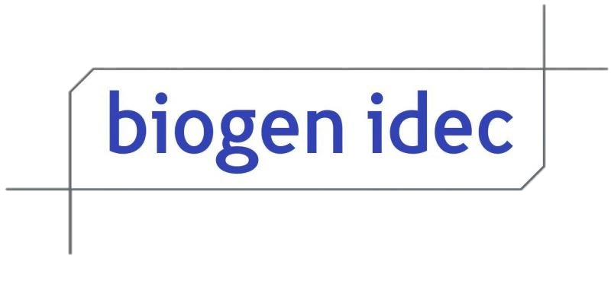







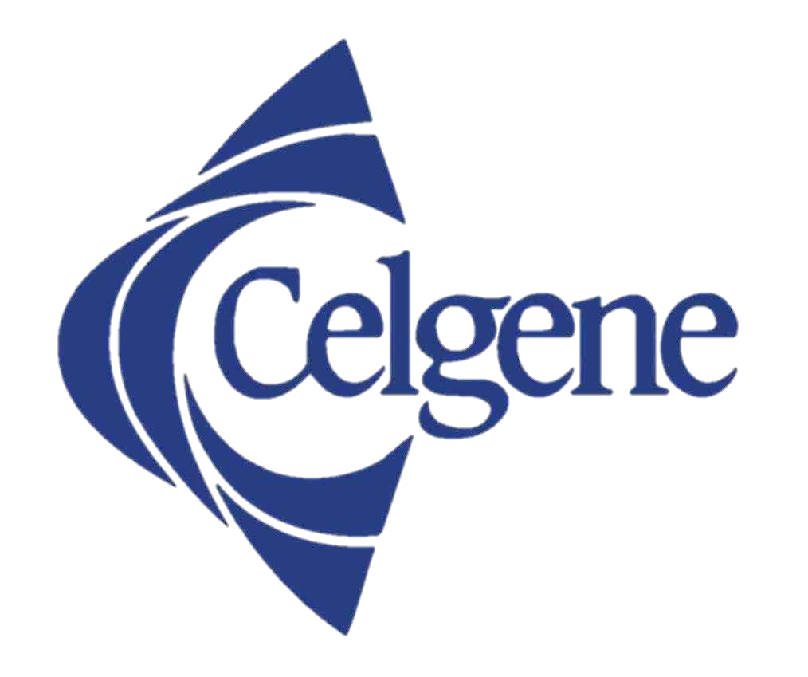










































Proudly Serving Innovative Life Sciences Organizations
Pharmaceuticals
Consumer Health
Medical Technology and Devices
Generics
Health Start-ups
Biotechnology / Biosimilars
Global Health Authorities
Wholesalers / Distributers
Service Providers
Biopharmaceutical
Medical Devices
CRO’s
Academic Institutions / Core Labs

Slide 10
The most complete platform in the industry and unified by the largest clinical data repository.
Notes:
Talking points
The most complete platform in the industry across the scientific and operational elements of clinical development and unified by the largest clinical data repository.

Slide 11
Mobile-Powered
& Virtual Trials
Mobile Health
Study Design & Feasibility
Cross-Industry
Benchmarking
Images
Genomics
RWE
Site Grants & Payments
Biomarker
Exploration
Automated
Payments
Site &
Lab Data
Rave
Edge
Strategic Monitoring
Auto-coding
MEDS
& AI
End-to-End
RBM
Data Capture
& Management
Trial Planning
& Management
Random-ization & Supply
CTMS
Adaptive &
Master Trials
Master Data
Management
Biostats
&Safety
eTMF
Synthetic
Controls
Automated
TMF
Notes:
Talking Points
Powered by Data and Analytics, the Medidata Clinical Cloud is the most complete collection of capabilities in the industry
From a scientific standpoint it combines the ability to ingest just about any type of study data---whether from apps, sensors, ePRO, images, or genomics---with the data management capabilities of randomization, supply management, coding, and safety
And from an operational and business standpoint, it combines intelligent study design, feasibility, site payments and grants with strategic monitoring as a complement to traditional CTMS and eTMF capabilities.
Transition: Let’s take a look at a few examples

Slide 12
Graphic: Security is #1 Priority
Security is
our #1 priority.
People
Security and Compliance
Expertise and Experience
Government regulation security certifications
Real-time security management 24X7
Process
Patient
Data
End-to-end security and privacy
Validated controls in place for application, IT and network systems
Advanced detection and response capabilities
Technology
Single point of access for all data types from any data source
Clinical Cloud Computing with high availability and security
Gain Actionable Insights Across a Unified Platform

Slide 13
Medidata’s Clinical Cloud Platform
Benefits our Customers have seen in Partnering with Medidata
Objective | Expected Results | Time | Cost | Quality
Increase Speed to Patient via CDMS | Faster study builds and database locks Reduction in data review, query, and serious adverse events (SAE) processing | ⬇ | ⬇ | ⬆
Richer Analysis and Sharing of Clinical Data | Continuous improvement driven by analytics | ⬇ | ⬇ | ⬆
Enable Complex and Innovative Studies | Single platform for all study types Faster and more comprehensive decision making | ⬇ | ⬇ | ⬆
Agility to Process Unique Patient Data Types | Agile clinical development platform Future-proofed against changes in disease area focus | ⬇ | ⬇ | ➔
Optimize Flexibility and Total Study Cost | Decrease data management costs by 25-45% | ⬇ | ⬇ | ➔
Reduce Operational, Compliance, and Technology Risks | Reduced risk based on Medidata technology Reduce risk based on R&D Services | ⬇ | ⬇ | ⬆
Positioned to Meet Global Regulatory Requirements | Highest level of global compliance today Medidata influence on the future of global regulations | ➔ | ➔ | ⬆

Slide 14




Medidata Implementation Team (MIT)
89+
19%
25%
Professional Services & Consultants
>10 YRS
of Service
5-10 YRS
of Service
Medidata Implementation Team
Focus on Innovation
Optimize IT environment for ease of adoption of Medidata Platform Capabilities
Process Optimization
Operational insight, governance and change management ensure optimized processes
Business Transformation
Industry best practices for business process transformation and optimization

Slide 15
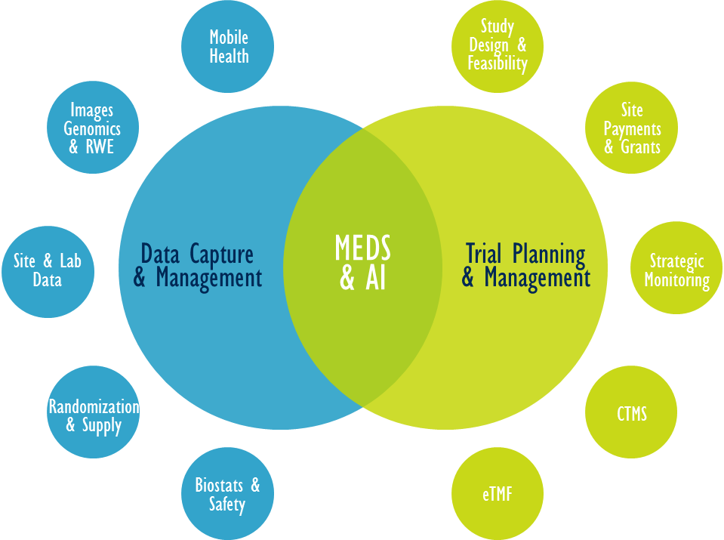

The MIT Advantage
Maximize the value of Medidata products by providing unmatched expertise in clinical trial processes and technology
Support entire MDSOL Solutions through unmatched expertise in clinical trial process and technology
Provide consultation as your “trusted advisor”
Provide post “go-live” support

Slide 16

Medidata Implementation Team
Startups to Small/Medium-Size Pharma or Biotech Companies
Global Health Care Companies, Medical Device Manufacturers, Diagnostic and Biomarker Developers
MID MARKET
MAJORS
MEDIDATA IMPLEMENTATION TEAM
PARTNERS
CROs, Services and Solution Partners

Slide 17
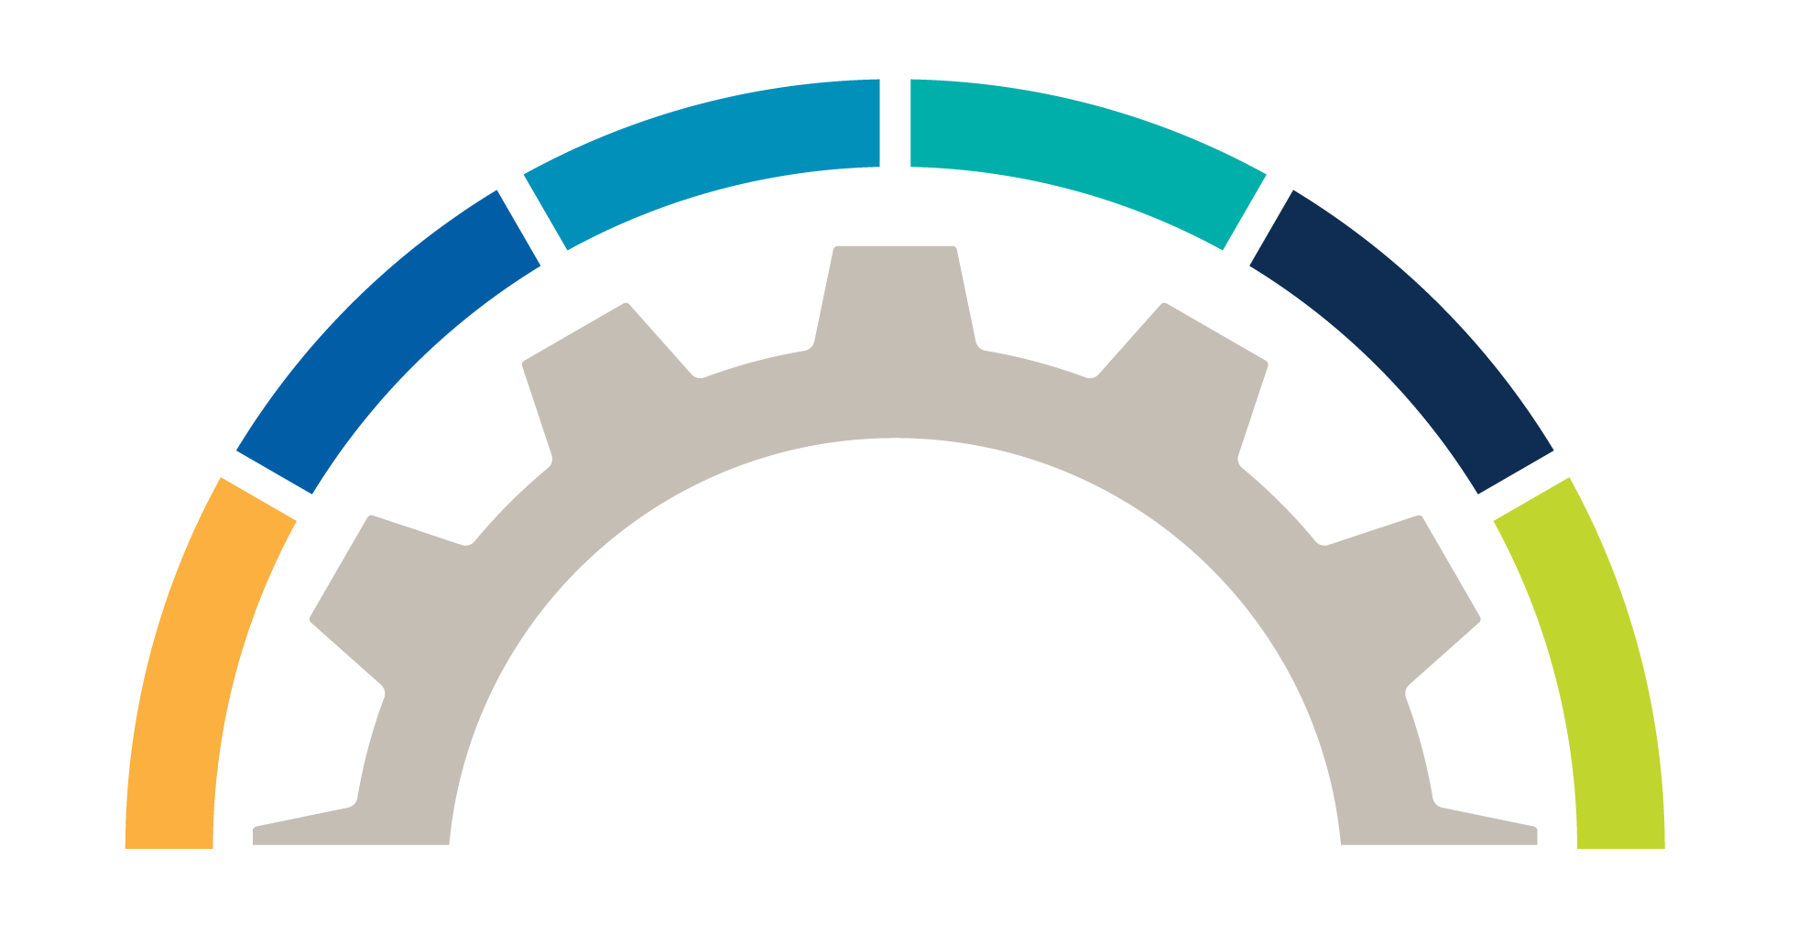
MIT Support’s Entire Medidata Platform
Operational Support Model
Program Management
Governance
Rave Offering
Ongoing support for your trial supply and randomization
Study Migration
Tool based approach to moving existing clinical data into our platform that is supported by optimized processes that ensure quality
Medical Device Offering
Custom offering with the scalability, configurability, and sustainability required by device/medical device
clinical trials
Unmatched Expertise
MIT
Phase One Offering
Configuration of Phase I studies leveraging eCRF forms and edit checks from a pre-configured library
Advanced Technical Services
Portal Integration Image Viewer Integration ODM Integration Custom Reports
End to End Implementation Across Medidata Platform
Notes:
Progressing to the Next slide

Slide 18





Medidata Implementation Team
Ensures customers maximize technology value through unmatched expertise
Medidata Expertise Provides…
Efficient Trials through…
Implementation
Proven methodology and consultative approach delivers fast, flexible and optimal trial design
Lower Costs and Reduced Risk
Medidata Implementation Team
Imaging
Proven imaging methodology insures seamless integration with EDC and 3rd party viewing tools while supporting Endpoint Adjudication Committees (EAC)/ Clinical Endpoint Committees (CEC)
Complete Support of Medidata Platform
Unmatched Expertise
Collaborative Project Management
Optimized Implementation
Technical Services
Accelerates your study through integration at the application, analytic and data levels
Operational Excellence
Delivery Optimization
Reduces issues found in UAT ensuring the integrity and reliability of clinical data through collaboration best practices between project designer and client tester
Fully Optimized Processes

Slide 19


Medidata Implementation Team Success
Proven Customer Results
95%
100%
1,000+
Customer Satisfaction
Customer Retention
Studies built to Date

Slide 20
Better Than Industry Median eCRF Study Design Cycle Times
Study | eCRF Design Period (Weeks)
PR-10-5014-C | 3.3
4010-01-001 Part 2 | 4.4
PR-11-5012-C | 5.6
OPEN LABEL QTC-PR-30-5011-C | 6.9
PR-11-5022-C | 7
PR-10-5013-C | 7.1
QUADRA_PR-30-5020-C | 10.9
4010-01-001 | 11.9
PR-11-5016-C | 12.7
4020-01-001 | 13.4
PR-30-5015-C | 15.1
PR-30-5017-C | 16.7
BRAVO PR-30-5010-C | 20
Directional Value Attainment Per Study Designed (Compared to industry median) |  | Notes
eCRF design period (in weeks) – Industry Median | 14 | From Medidata Insights
eCRF design period (in weeks) – Tesaro | 10 | From Medidata Insights
Tesaro's study design is faster than Industry Median by (in weeks) | 4 | Calculated (=14 weeks - 10 weeks)
Number of FTEs designing studies | 2 | Estimate validated by Tesaro team
Number of hours saved (40 hours per work week) | 320 | Calculated (=4 weeks * 2 FTEs * 40 hours per week)
Data Manager cost per hour to design eCRF | $135 | Medidata PICAS benchmark
Total study design cost savings per study | $43,200 | Calculated (=$135 per hour * 800 hours)
Total study design cost savings across all 17 studies | $561,600 | Calculated ($43,000 savings per study * 13 studies)
Average eCRF design period cycle time =
10 weeks; industry median = 14 weeks
* Data for studies 3000-PN162-01-001, PR-20-5006-C, PR-11-5021-C may not represent actual eCRF design periods since the builds were started and then put on hold; to avoid skewing the results these three studies were not included in the analysis.

Slide 21
MIT Case Study: Driving Operational Excellence
Reductions in eCRF Design Period from Implementing Global Library
Key Value Drivers
Customer #1, #2, and #3 proactively managed the eCRF design process and maximized the value of standards
Leveraged the Global Library to facilitate the process of reusing study components
Drove efficiency in study startup resulting in reduced duration to “go-live” through improved study startup efficiencies
Their Global Library contained validated DEC elements (forms, edit checks, etc..) resulting in reducing the need for additional testing (which further reduced the cost of the validation process)
64% Reduction | 47% Reduction | 46% Reduction
Customer 1 reduced Phase II and III study design periods from 19 weeks to 6.7 weeks Current Global Library reuse = 28% | Customer 2 reduced Phase II and IV study design periods from 18.9 weeks to 10 weeks Current Global Library reuse = 78% | Customer 3 reduced Phase I, II and III study design periods from 11.0 weeks to 6 weeks Current Global Library reuse = 71%
Data illustrated in the proof points above are current as of March 2016. Data Source: Medidata insights Trend Analysis for eCRF Design Period and, eCRF reuse and eCRF reuse from Global Library.
Notes:
List out Customer 1-2-3 – remove words in gray
Reduced duration of go-live through improved study startup efficiencies
Reduced costs and need for additional test validations
Maximized the value of standards through proactively managing eCRF design process

Slide 22
MIT Medidata Solutions Enable your Process
Mobile-Powered
& Virtual Trials
Mobile Health
Study Design & Feasibility
Cross-Industry
Benchmarking
Images
Genomics
RWE
Site Grants & Payments
Biomarker
Exploration
Automated
Payments
Site &
Lab Data
Rave
Edge
Strategic Monitoring
Auto-coding
MEDS
& AI
End-to-End
RBM
Data Capture
& Management
Trial Planning
& Management
Random-ization & Supply
CTMS
Adaptive &
Master Trials
Master Data
Management
Biostats
&Safety
eTMF
Synthetic
Controls
Automated
TMF

Slide 23


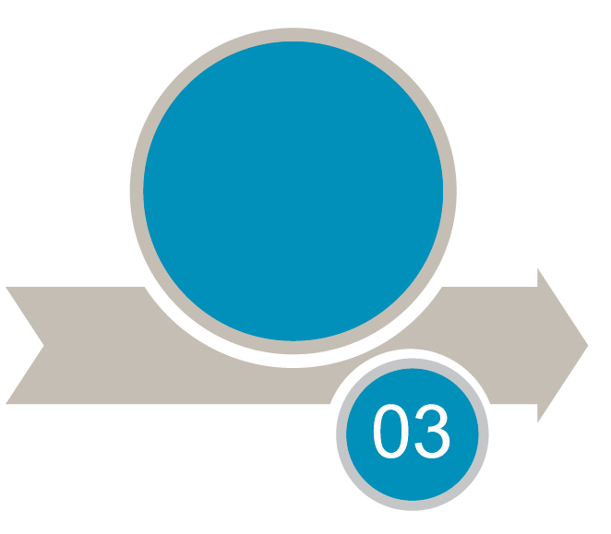
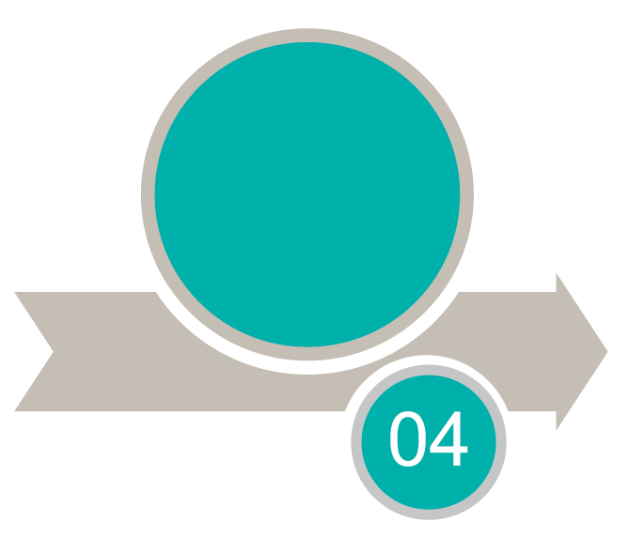




MIT Solution Implementation Life-Cycle (SILC)
Full project life-cycle support
Startup
Implement
Live
Conclude
Joint development of SO based on requirements
Project development meeting, setup, and protocol review
Develop, test and deploy all components
Full project life-cycle On-going Support for business users/roles involved
Change Management
Provide End-of-Project deliverables identified in Project development meeting; Database lock
Notes:
23

Slide 24

MIT Processes are Enablers of Success
Reduce risk through collaborative project management
leveraging standardized best practices with technologies: ie. Smartsheet, C-dash Organization, Zendesk, Google Suite, and SILC
Save time with a proven, evolving and innovative methodology
for rapid configuration of Medidata platform
Unmatched enterprise and experience
accelerating your clinical trial while ensuring high quality
Notes:
Reduce risk through collaborative project management
The Medidata project manager works closely with the sponsor and other parties to guide the project forward, manage key handoffs and communicate next steps and expectations. This collaborative approach is supported by project management technologies such as Smartsheet, a web-based application shared between team members that provides the project schedule—including activities, due dates, key milestones and responsibilities—meeting minutes and key contact information. Smartsheet sends an email alert to team members each morning when any changes have been made to the project.
Save time with a proven, evolving and innovative methodology
Medidata has developed a unique implementation methodology that allows for? Rapid configuration of the Medidata platform. The methodology guides the client through engagement by clearly defining expectations and touch points between team members. By leveraging Rapid Study Builder—a cloud-based tool used for collecting, recording and approving user requirements—appropriate team members can engage in efficient communication and perform real-time configuration updates.
Unmatched expertise and experience
Unmatched expertise and experience that ensures that your study will be built using best practices, accelerating your clinical trial while ensuring high quality

Slide 25


MIT Setting New Standards for Image Management
GLOBAL EXPERIENCE
POWERFUL API’s
Configurable Workflow Management
Imaging Accreditation Program
100+ Countries
5,500+ Global Sites
Broad expertise in a variety of therapeutic areas
EDC integration
Experience with 3rd party viewing tools
Support in Event Adjudication (EAC)
Support in Clinical Events Committee (CEC)
Instructor-led courses incorporate real-world examples
Hands-on experience tailored to roles

Slide 26

MIT eConsent Customer Realized Value
Configuration
Realized Value
Assign
Build
Define
Design
Develop
Deliver
Patient
Centric
Efficient
Trials
Faster Study
Start up
Reduced
Study Risk
Integrated
Platform
Workshops
Process Flow
Video Scripts
URS
Reviews
Feedback
App Mockups
User Stories
Storyboards
Integration
Demo
Test
Release
QA
UAT/Integration
Finalization
Document
Go-Live
75% Memory recall with Enroll®
58% Memory recall with Paper
Patient Centric Design
Improve Patient Site Relationship
Qualified Patients
Reduce patient drop outs
Reduce monitoring costs
Automated reporting
Real-time visibility of enrollment data
Remote consent patients
Reduce audit and inspection findings
Manage consent versions and amendments
Zero loss paperwork
Reduce cost with Integrated Platform
Approval
Feedback
Application Design
Configuration
(5-12 weeks)

Slide 27




MIT Edge eTMF Ensuring Seamless Management of your Regulated Content
Edge Quality with Edge Quality with SOP Implementation
Document Migrations / Archive Implementation
Integrated platform for managing both regulated and nonregulated content
Incredibly intuitive even for the occasional user. Mobile accessible. Users can quickly find the content they need, when they need it.
Document Migration Consulting
Edge Upgrade Support
Rapid deployment with minimal resources, supported by pre-built, pre-validated functionality and validated content migration
Administration Support
Edge Quality with SOP Consulting
Cost-effective
by leveraging scalable cloud technology
Edge eTMF Consulting
Edge eTMF Management and Implementation

Slide 28
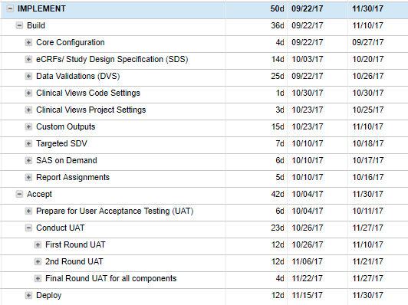
MIT Typical Implementation Timeline
CORE CONFIGURATION
DATA VALIDATION (DVS)
CLINICAL VIEWS CODE
25 Days
1 Day
Build
Weeks 7- 8
4 Days
14 Days
3 Days
15 Days
5 Days
6 Days
7 Days
REPORT ASSIGNMENTS
eCRFs/STUDY DESIGN SPECIFICATION(SDS)
Conduct (UAT)
SAS ON DEMAND
CUSTOM OUTPUTS
TARGETED SDV
CLINICAL VIEWS PROJECT
final Round
  (UAT) FOR ALL
  COMPONENTS
Prepare for User Acceptance Testing (UAT)
First Round (UAT)
SECOND Round (UAT)
ACCEPT
Weeks 8 - 9
6 Days
6 Days
12 Days
23 Days
4 Days
12 Days
DEPLOY

Slide 29
Strengths of Medidata Implementation Team
Unmatched Expertise Ensuring Optimized Trial Outcomes
All Medidata Solutions
Study Build Time
Quality of Build
Flexible Resource Pool
Focus on Core Competencies
Experienced in implementing Medidata’s latest solution versions
Multi-product deployments
Single contract – no 3rd party contracts (Rave Imaging, Rave eCOA/ePRO)
Faster build times
Attaining target FPI dates
Faster subsequent studies
Access to latest training and industry best practices
Continuous process improvements
Global distribution of resources
Customer’s build hope
Medidata accelerates it

Slide 30

Professional Services Helps Ambit Biosciences Successfully Rescue Three Critical Oncology Studies
The Challenge
Ambit needed to transition three critical oncology studies in progress
Limited to a tight six month period to for complete transfer of knowledge,
documentation and data
Resources strained with volume of study data and time needed for migration
The Solution
“The Medidata Professional Services team led us through the transition process step by step and provided us options along the way. They made recommendations based on our specific needs and style of working. ”
Mar Reyes
Director of Data Management
Ambit Biosciences
Medidata Professional Services reconfigured roles and workflows for each of the three studies to better fit Ambit's needs and available resources
Medidata Project Manager provided recommendations for timelines and transitions based on their experience
Restructuring of Rave databases – including identifying missing elements from original setup
Data loaded through Rave Web Services & Synonym tables though Rave Coder
The Results
Successful study setup with tight timeline constraints and no data loss
Tailored solution for Ambit’s needs based on Professional Service experience
Transparency during data transfer process and seamless process and reassurance for sites
30

Slide 31

Onconova finds success with a flexible study build model using Medidata Rave
The Challenge
Manual efforts around patient screening
Non-documented communication to sites finding eligible candidates
Variable internal resource availability for study build process
The Solution
“We didn’t go shopping, we knew we wanted to use Medidata and it was a matter of working to find the right model to fit our business needs. ”
Patrick Zbyszewski,
Director of Clinical Data Management,
Onconova Therapeutics
Flexible study build models depended on resource availability and
URL ownership including
Outsourcing the database build
Working with Medidata Implementation services to build studies
Knowledge Transferred enabled to configure their own enablement
The Results
Versatility to outsource data management but maintain data collection in central location
Custom functionality built with shared experience from Medidata’s Professional Services team including notifications and an audit trail of the eligibility discussion
Reduced costs contracting third party builders
Eliminated redundancies and efforts starting new projects leveraging a standardized study build operation
31

Slide 32

Tesaro pushes Medidata Rave to New Capabilities
The Challenge
Tesaro looked to Medidata’s Rave offering to find a solution to help manage clinical trial supplies for an adaptive trial
Tesaro need a flexible system to adjust dosing and cohort sizes within specific patient populations
The Solution
“The partnership with Medidata resulted in a drug supply management system that included the functionality and priorities we needed, which resulted in a pooling of investigational product at the depot and investigator site levels to maximize the efficient use of the drug ”
Simona Cipra
VP of clinical operations from Tesaro
Co-development of new functionality within Medidata Rave to enable users to pool clinical supply inventory across multiple trials at the same research site
The Results
40% Reduction in packing waste
34% Reduction in shipping costs
35% Reduction in data entry time
Flexibility and agility to the clinical supply chain
32

Slide 33
Thank you.
Notes:
Design notes
We will develop a series of thank you slides with different images.
Talking points

Slide 34
Backup.

Slide 35
Unified
Platform
Notes:
Talking points

Slide 36
Unified Platform
Up to
35%
$26B
25
increase in high-complexity studies
average cost per drug
discrete systems
Notes:
Talking points
In support of “Unified Platform” – Foundation for the future
state of the industry
$26B Average cost per drug developed – up from ~1B in early 2000’s
Up to 25 discrete systems a single trial runs on with isolated data repositories

Slide 37
Unrivaled expertise
Notes:
Talking points

Slide 38
Unrivaled Expertise
46
>200
4x
Novel drug approvals, doubled YoY
innovative, outcomes-based contracts executed world-wide
two-year increase in chief digital officers in pharma
Notes:
Talking points
In support of “Unrivaled Expertise” – Technology Leadership
Dominance in Oncology (46 novel drug approvals = more than doubled the previous year representing a 21-year high

Slide 39
Pioneering
analytics
Notes:
Talking points

Slide 40
Pioneering Analytics
69%
4x
3x
increase of precision medicines in the next 5
use of medical sensors
increase in likelihood of trial success when including biomarkers
Notes:
Talking points
In support of “Pioneering Analytics” – Transforming Clinical Development
4x increase in the use of Medical sensors — and is predicted to triple by 2020
+69% of precision Medicines in the next 5 years

Slide 41
We power operational and scientific innovation with MEDS, the largest dataset in the industry.
Notes:
Talking points
We power operational and scientific innovation with MEDS, the largest dataset in the industry, embedded into data discovery and data science applications.

Slide 42

Customers Rank Medidata Professional Services #1 in Recent Life Sciences Strategy Group Survey
 | Time to complete project | Quality of Implementation | Accessibility of PS Expertise post-implement | Average Score
MEDIDATA | 3% | 3% | 3% | 3%
ORACLE | (1%) | 1% | 1% | 1%
PAREXEL | (2%) | (3%) | (3%) | (2%)
BioClinica | (0%) | (2%) | (1%) | (1%)
veeva | 1% | 1% | (2%) | (0%)
IQVIA | (1%) | 1% | 1% | (0%)
Covance | (0%) | (2%) | 1% | (0%)
Medidata Transformational Services Leading the Way:
Accessibility to Unrivaled Expertise
Quality of Implementation
Time of Project Completion
PS w/ Percent Above/Below Average
Survey of Life Science end-users and decision makers in July 2017. N=120. Survey conducted by Life Science Strategy Group in partnership with Medidata Market/Competitive Intelligence
Notes:
Details
Survey of decision maker & end-user perceptions of EDC, CTMS, RBM, Payments, Trial Error Detection and SOP Management products
Scores weighted based on # of responses in each product category for each vendor
Veeva EDC and CTMS scores (which were recently launched) based on customer perceptions and prior experience w/ Veeva
Same situation w/ Medidata SOP Management

Slide 43
Customers Rank Medidata Professional Services #1 in Recent Life Sciences Strategy Group Survey
Medidata Professional Services Customers Rank us #1* in:
Transforming Medidata
Customers into Market Leaders:
Accessibility to unrivaled Expertise
Quality of Implementation
Time of project Completion
Transforming customers business to get products to patients Faster
Reduced risk, Improved performance and Cost-Saving optimized processes
Increased Profitability and Faster Response to market challenges
*Survey of Life Science end-users and decision makers in July 2017. N=120. Survey conducted by Life Science Strategy Group in partnership with Medidata Market/Competitive Intelligence
Notes:
Details
Survey of decision maker & end-user perceptions of EDC, CTMS, RBM, Payments, Trial Error Detection and SOP Management products
Scores weighted based on # of responses in each product category for each vendor
Veeva EDC and CTMS scores (which were recently launched) based on customer perceptions and prior experience w/ Veeva
Same situation w/ Medidata SOP Management

Slide 44








MIT Provides a Flexible and Adaptive Change Management
Create Sponsorship
Committed sponsorship
= most important for
successful implementation
Anticipate Resistance
Inevitable resistance to change, must be managed
Work Instructions
Understand
Organizational Readiness
Identify new roles & leverage existing talent
SOP’s
2
Training
4
1
6
Measure Adoption
& Performance
Continuous evaluation of change & actions → remediate issues
5
7
3
Define the Change
Common definition of current & desired future state
Develop Communication Plan
Clear, concise, timely & check for understanding
Decide Change Approach
Rewards and incentives for compliance and commitment

Slide 45
Program Structure
Executive Steering Committee
  Roadmap Strategy
  Performance & Benchmarking
  Relationship & Governance
  Resolve Escalated Issues
  Set Strategic Direction & Initiatives
Meet Quarterly
“Best Practices” Approach to maximizing the value of each workstream
Executive Alignment & Commitment
Blended team with single accountability
Program Governance Committee
  Program Review & Governance
  Review of QA/CAPA
  Manage General Delivery Issues
  Program ‘Health Status’ Management
  Issue & Escalation Prioritization
Meet Monthly
Program Management Office
  Program Oversight and Management
  Scope Control
  Financial Management
  Issue, Risk Management & Escalation
Meet
Bi-Weekly
Clinical Operations
Data Management
Biostats
Data Migration
Quality
Training
Meet Weekly/
as Required
CORE WORKSTREAMS

Slide 46

Value Governance
**Entry Point
Value Identification
Value Attainment
Measure value attained
• Track KPIs at regular cadence
• Take corrective action if required
• Measure, report, correct, measure
Value Optimization
Conduct value assessment
Benchmark Performance
Value model development
Value quantification
**Entry Point
**Entry Point
Establish value governance framework
• Evaluate performance of key clinical research capabilities
• Identify, validate, and prioritize value driving metrics
• Baseline metrics, set performance targets and engage in process optimization
Note: **Entry Point, denotes different points at which Sponsors/CRO’s can enter the value lifecycle.

Slide 47
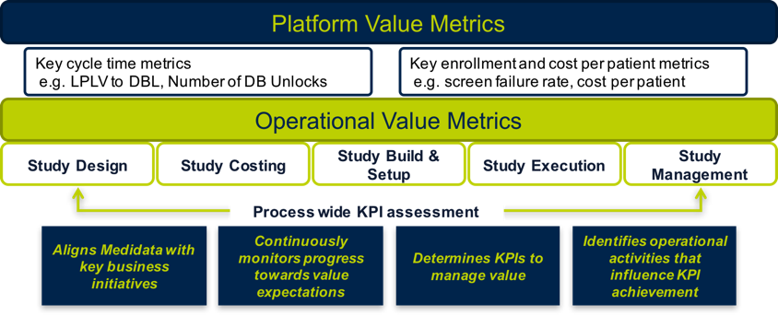
Value Governance (How)
Strategic Objectives
20% Faster Cycle Times
Sponsor of Choice
20% Cost Reduction
Quantifiable
Attainable
Measureable
Value Optimization
Value Attainment
Value Identification
KPI’s
KPI’s
KPI’s
Initiatives
People
Processes
Technology

Slide 48
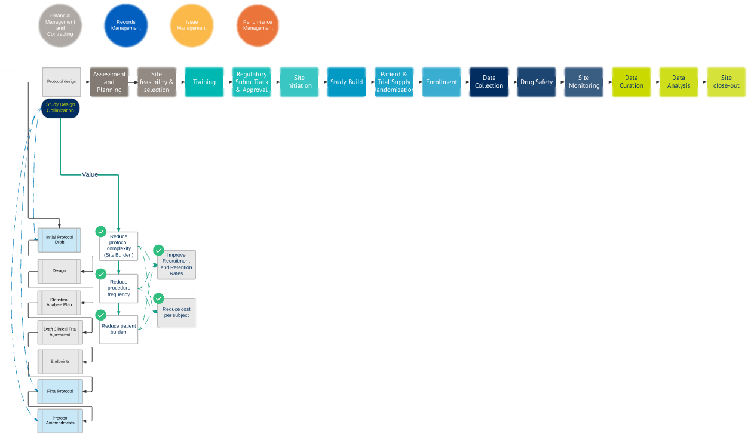
Example - Medidata products supporting value drivers and KPI’s
Study Design
Study Processes
Medidata Products
Objective
For the activities where Medidata has supporting Products available, we can define value drivers which Medidata’s Value Team can measure and recurrently report to Sanofi
Study Activities
& Value Drivers
KPI’s

Slide 49

RAVE ENROLL – VALUE DRIVERS
Patient
Centric
Efficient
Trials
Faster Study
Start up
Reduced
Study Risk
Integrated
Platform
49

Slide 50
Professional Services Configuration
Assign
Build
Define
Design
Develop
Deliver
Demo
Test
Workshops
Process Flow
Video Scripts
URS
Reviews
Feedback
App Mockups
User Stories
Storyboards
Integration
Release
QA
UAT/Integration
Finalization
Document
Go-Live
Approval
Feedback
Application Design
Configuration
(5-12 weeks)

Slide 51
MIT Processes are Enablers for Your Success
Leveraging Technology, Expertise and Optimized Process to Move Quickly, Efficiently and Collaboratively
Reduce Risk
Save Time
Expertise
Collaborative Project Management
Interactive Technologies like Smartsheet providing real-time project schedule updates
Optimize your processes leveraging Best Practices
Define your success factors & performance measures
Proven, Evolving and Innovative Methodology
Enables rapid configuration of Medidata Platform
Guiding principles with touchpoints through engagement
Leverage Rapid Study Builder to collect, record and approve user requirements
Unmatched Expertise and Experience: 420,000+ Study Sites
Proven Best Practices to accelerate clinical trials and ensure high quality
Subject Matter Experts on Medidata Platform and design across therapeutic areas

